Slide 1


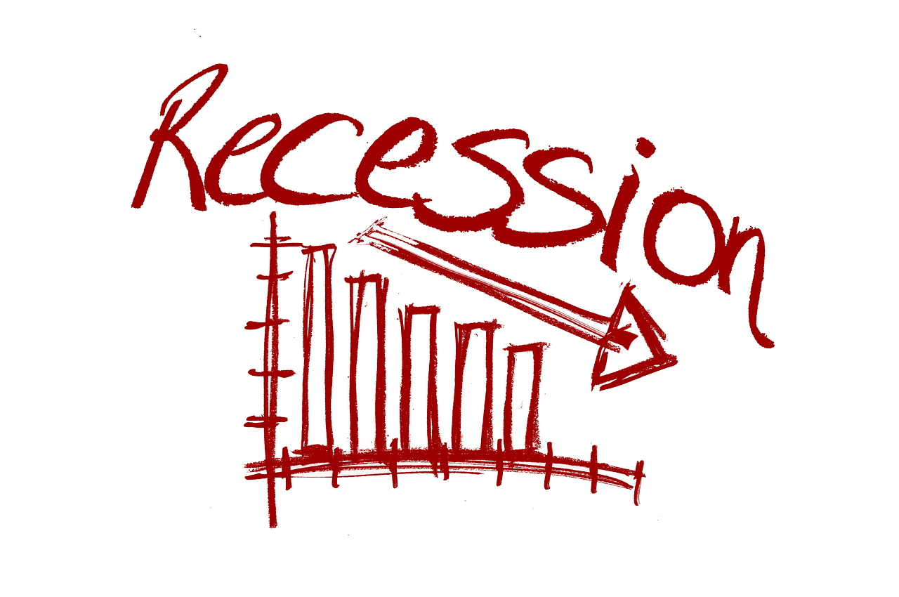
RECESSION ANALYSIS
PG-Diploma in Big Data Analytics (PG-DBDA)
Project Group : 08
Guided By:
Mr. Saurabh Panwar
Submitted By:
Bisure Prateek Pratapsinh (230940125010)
Kodak Rishikesh Pradeep (230940125027)
Munfan Aditya Ramrao (230940125029)
Mali Omkar Nandkumar (230940125032)
Tambolkar Shubham Dilip (230940125051)

Slide 2
Introduction
GDP – Gross Domestic Product
Gross Domestic Product (GDP) and Recessions are key components in assessing the economic health of a country.
GDP measures the monetary value of final goods and services-that is, those that are bought by the final user-produced in a country in a given period of time (say a quarter or a year)
It counts all of the output generated within the borders of a country
Components of GDP :
Consumption (C): Expenditures by households on goods and services.
Investment (I): Spending on capital goods, such as machinery and buildings, and changes in business
inventories.
Government Spending (G): Expenditures by the government on goods and services.
Net Exports (Exports - Imports): The value of a country's exports minus its imports.

Slide 3
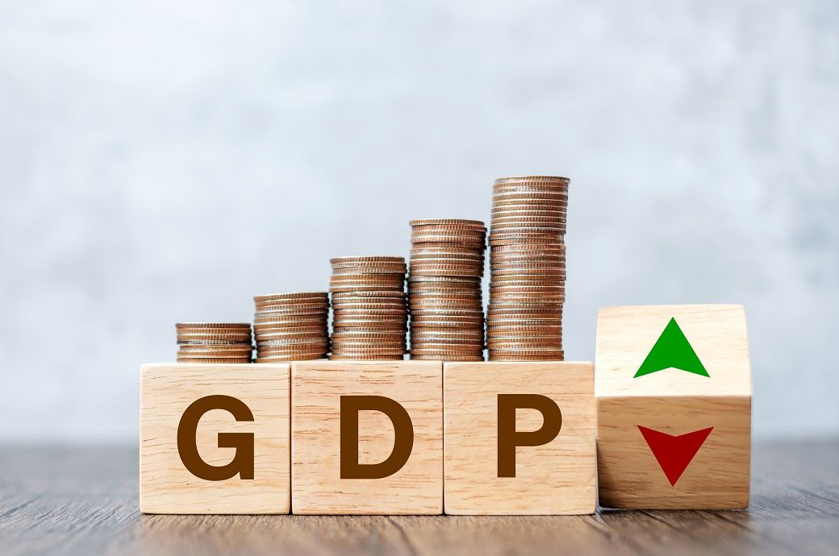
Theoretically, GDP can be viewed in three different ways:
The production approach
The expenditure approach
The income approach

Slide 4
Understanding Economic Recession
Definition of Recession
A recession is a significant decline in economic activity across the economy, lasting for an extended period, typically marked by a contraction in GDP, rising unemployment, and decreased consumer and business spending
Indicators of a Recession
Negative GDP Growth
Unemployment Rate
Consumer and Business Confidence
Stock Market Performance

Slide 5
Recession Causes and Impacts
Causes: Recessions can be triggered by various factors such as a financial crisis, high levels of debt, external shocks, or a combination of these.
Impacts: Recessions lead to reduced income, increased unemployment, lower consumer spending, decreased business inv
Policy Responses
Monetary Policy: Central banks may lower interest rates to stimulate borrowing and spending.
Fiscal Policy: Governments may implement stimulus packages, tax cuts, or increased public spending to boost economic activity.
Long-Term Economic Health
GDP Growth Rate: Positive and sustained GDP growth is essential for long-term economic health.
Structural Reforms: Governments may implement reforms to improve productivity, enhance competitiveness, and address underlying economic issues.

Slide 6

Dataset & Features
Data used in this project is collected in the different csv and excel files and then combined to form a dataset which is used for the further processing and evaluation.
Dataset contains 5 columns:
• Country
• Date
• GDP (US Billion $)
• GDP per Capita (US $)
• Annual % Change
There were total 1525 values in the dataset.

Slide 7
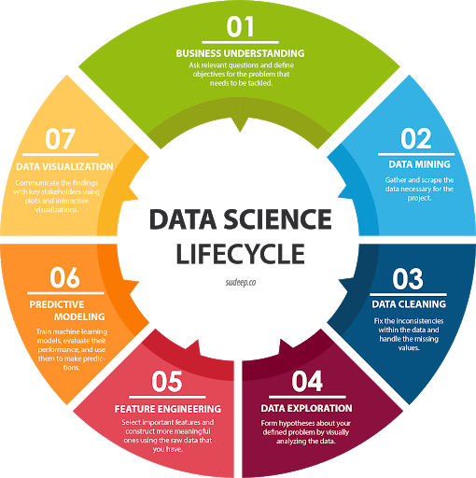
Life - Cycle

Slide 8

Functional Requirements
Python3
• Python is a general purpose and high-level programming language.
• It is used for developing desktop GUI applications, websites and web apps.
• Python allows to focus on core functionality of the application by taking care of common
programming tasks.
• Python is derived from many other languages, including ABC, Modula-3, C, C++, Algol-68, Small Talk,
and Unix shell and other scripting languages.

Slide 9

Functional Requirements
Tableau
• Data visualization is the graphical representation of information and data.
• It helps create interactive elements like charts, graphs, and maps, data visualization tools provide an accessible way
to see and understand trends, outliers, and patterns in data.
• Tableau is widely used for Business Intelligence but is not limited to it.
• It helps create interactive graphs and charts in the form of dashboards and worksheets to gain business insights.
• All of this is made possible with gestures as simple as drag and drop.

Slide 10
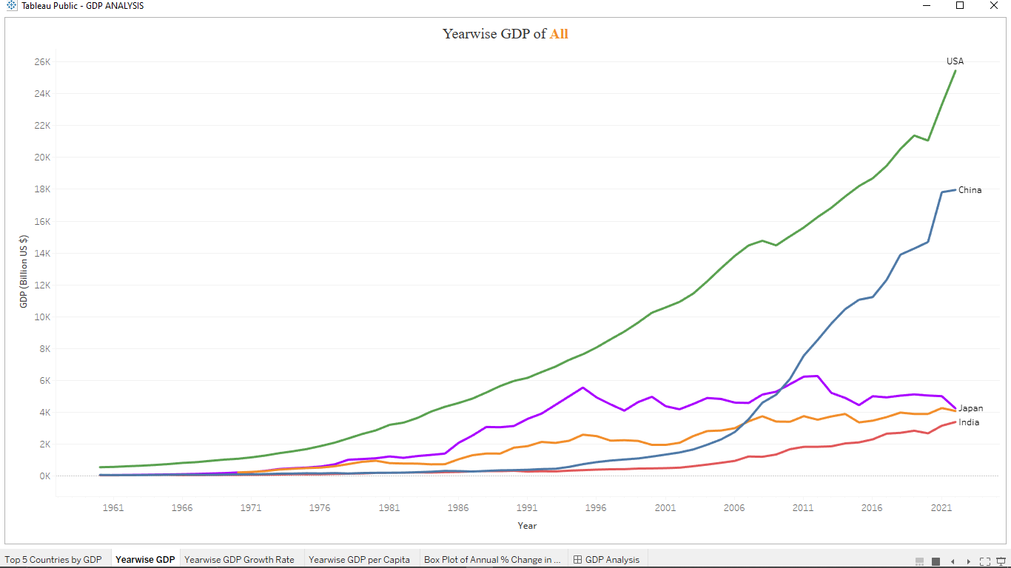
Visualization
Data Visualization: Created interactive and insightful visualizations using Tableau.
Dashboard Creation: Designed dashboards to present different Country GDP data.
Interactive Analysis: Enabled users to explore and understand the data through interactive visualizations.
https://public.tableau.com/views/GDPANALYSIS_17079692956640/GDPAnalysis?:language=en-US&:sid=&:display_count=n&:origin=viz_share_link

Slide 11
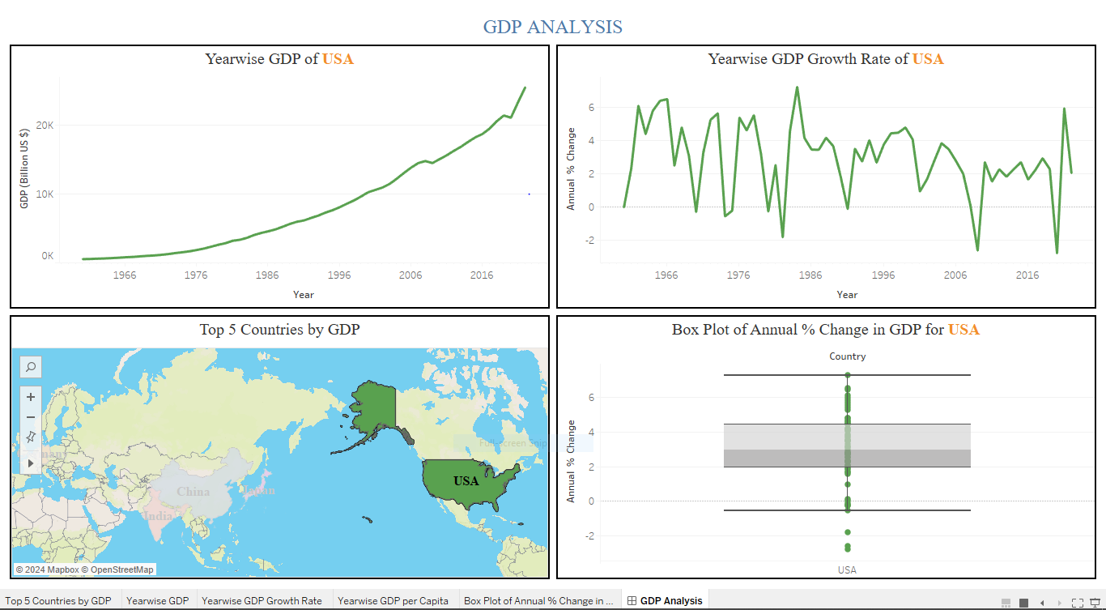
Dashboard Snapshots

Slide 12
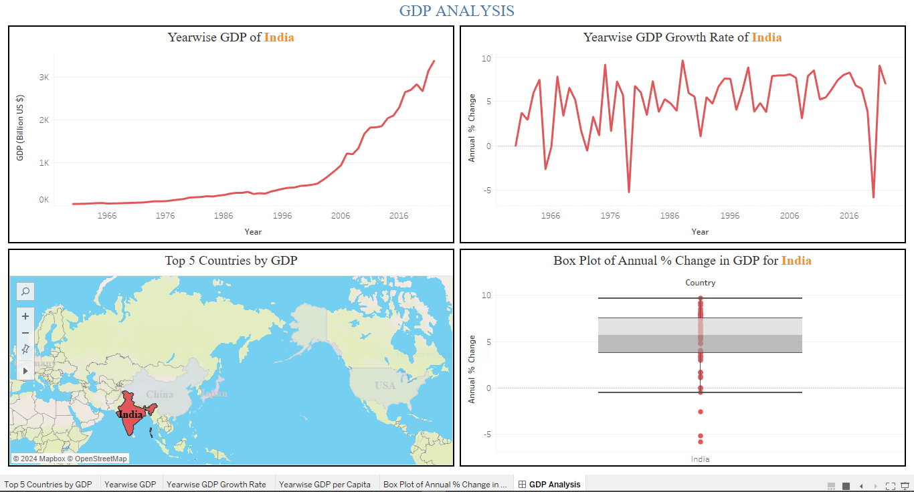
Dashboard Snapshots

Slide 13
Forecasting with Machine Learning
Machine Learning -
Machine learning (ML) is a discipline of artificial intelligence (AI) that provides machines with the ability to automatically learn from data and past experiences while identifying patterns to make predictions with minimal human intervention.
Machine Learning Working-
Machine learning algorithms are molded on a training dataset to create a model.
As new input data is introduced to the trained ML algorithm, it uses the developed model to make a prediction.

Slide 14
Forecasting with Machine Learning
Advantages of ML for Forecasting over Traditional methods –
Machine learning can identify patterns that are too complex for humans to observe.
Machine learning is not as biased by human emotions or subjective opinions.
Machine learning can adapt to changes quickly
Machine learning is not as easily manipulated as traditional methods.
Machine learning is a more efficient use of resources
Machine learning is more accessible than traditional methods

Slide 15
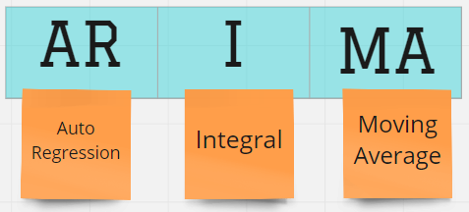
ARIMA
ARIMA – Auto-Regressive Integrated Moving Average.
Time series analysis involves modelling and forecasting data points collected over time. ARIMA, which stands for Auto-Regressive Integrated Moving Average, is a popular statistical model widely used for time series forecasting. It combines autoregression, differencing, and moving averages to capture different aspects of time series data.
Autoregressive integrated moving average (ARIMA) models predict future values based on past values
ARIMA makes use of lagged moving averages to smooth time series data.
They are widely used in technical analysis to forecast future security prices
Autoregressive models implicitly assume that the future will resemble the past.

Slide 16
Components of ARIMA:
AutoRegressive (AR) Component (p) -
The autoregressive component represents the relationship between the current observation and its past observations.
The parameter 'p' denotes the order of the autoregressive component, indicating how many past observations are considered in the model.
Integrated (I) Component (d) -
The integrated component involves differencing the time series data to make it stationary.
The parameter 'd' represents the number of differencing required to achieve stationarity.
Moving Average (MA) Component (q) -
The moving average component captures the relationship between the current observation and a residual error from a moving average of past observations.
The parameter 'q' denotes the order of the moving average component, indicating how many past residuals are considered in the model.

Slide 17
Working of ARIMA Model
Data Pre-processing : Time series data often has trends and seasonality. ARIMA assumes the data to be stationary, so pre-processing steps like differencing may be needed.
Model Specification : The order of the ARIMA model is specified by (p, d, q) parameters. Choosing appropriate values for these parameters is crucial and can be done using methods like grid search or analyzing autocorrelation and partial autocorrelation plots.
Model Training : The ARIMA model is trained using historical time series data. The model estimates coefficients for the autoregressive, differencing, and moving average components.
Forecasting : Once trained, the ARIMA model can be used to make future predictions. Forecasting involves generating predictions based on the learned patterns and relationships in the historical data.

Slide 18
Why to use ARIMA
ARIMA models are more accurate and robust in short term forecasts
ARIMA models can account for various patterns, such as linear or nonlinear trends, constant or varying volatility, and seasonal or non-seasonal fluctuations.
The ARIMA (Autoregressive Integrated Moving Average) model is commonly used for GDP forecasting. It has been applied in various studies to forecast GDP for different countries.
The ARIMA model helps in identifying the factors affecting GDP and predicting its future trends.
A key aspect of ARIMA models is that in their basic form, they do not consider exogenous variables. Rather, the forecast is made purely with past values of the target variable

Slide 19
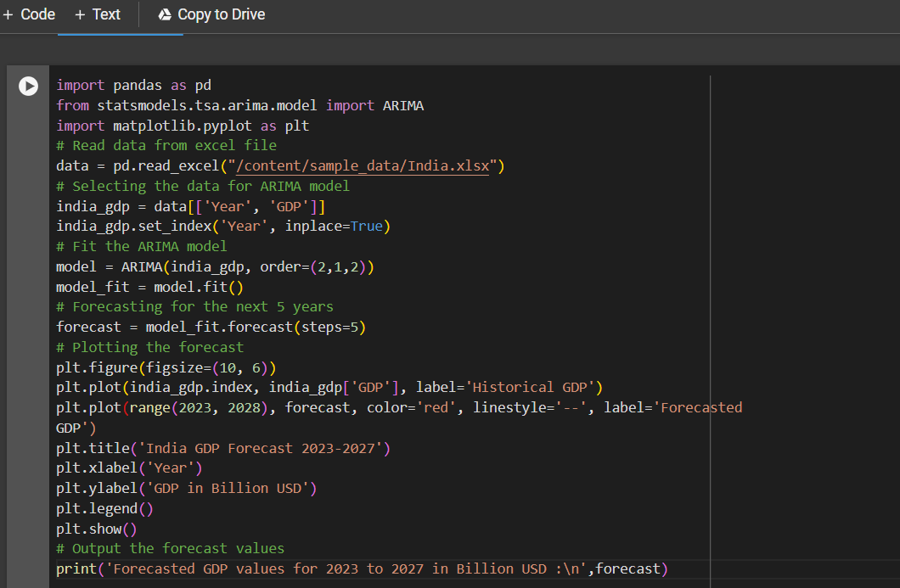
Python Code for Forecasting

Slide 20
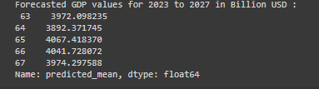
Output From ARIMA Forecasting
Output of Forecasted GDP Values for Japan (in Billion USD) -

Slide 21
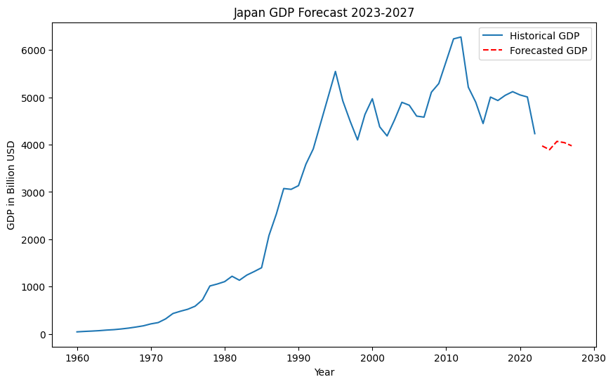
Forecasting Results using ARIMA

Slide 22
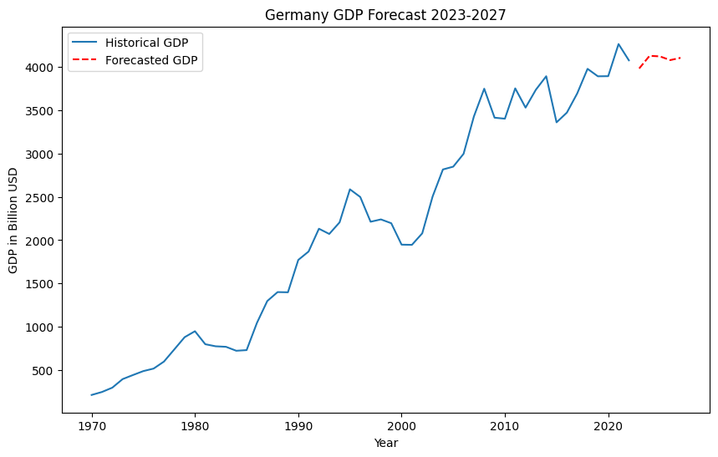
Forecasting Results using ARIMA

Slide 23
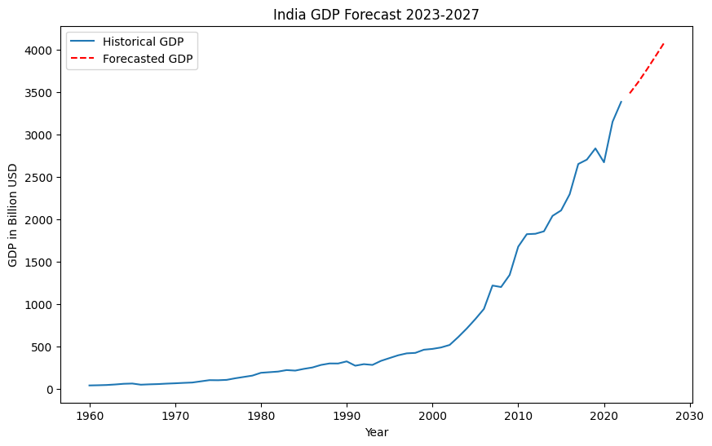
Forecasting Results using ARIMA

Slide 24
Thank You !!

